Slide 1
Components for grouped optimization
Link - ElectricalLine

Slide 2

Link
https://oemof-solph.readthedocs.io/en/latest/reference/oemof.solph.html#oemof.solph.custom.link.Link
In-development component
One link can connect two buses in both directions
Possibility to convert the buses, different factors considering the direction
Bus 1
Bus 2

Slide 3
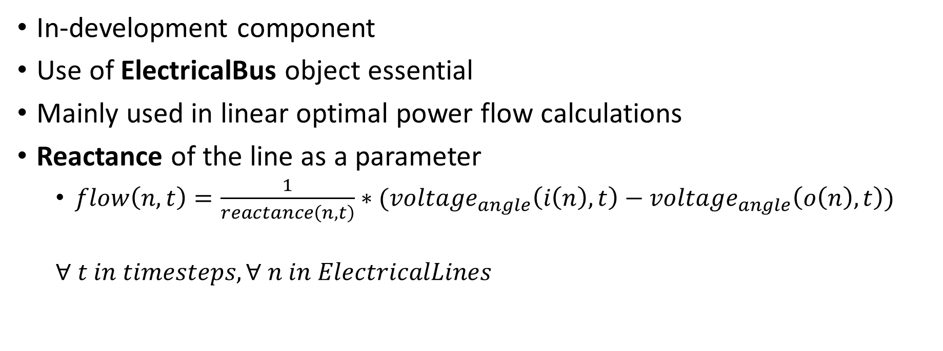
ElectricalLine
https://oemof-solph.readthedocs.io/en/latest/reference/oemof.solph.html#oemof.solph.custom.electrical_line.ElectricalLine
In-development component
Use of ElectricalBus object essential
Mainly used in linear optimal power flow calculations
Reactance of the line as a parameter
$flow\left(n,t\right)=\frac{1}{reactance\left(n,t\right)}∗(voltage_{angle}\left(i\left(n\right),t\right)−voltage_{angle}\left(o\left(n\right),t\right))$
$∀ t in timesteps, ∀ n in ElectricalLines$

Slide 4
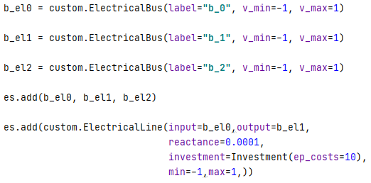
ElectricalLine
https://oemof-solph.readthedocs.io/en/latest/reference/oemof.solph.html#oemof.solph.custom.electrical_line.ElectricalLine

Slide 5
Use examples
Link:
oemof-moea/liboemof.py at master · matpri/oemof-moea (github.com)
OSeEM-DE/base-NDE-SDE.py at master · znes/OSeEM-DE (github.com)
ElectricalLine:
oemof-examples/lopf.py at master · oemof/oemof-examples (github.com)

Slide 6
More parameters ?
If a more detailled model is required, the OEMOF.TABULAR package offers costs in relation with the link created: capacity costs and activity costs
oemof.tabular package — oemof.tabular 0.0.2dev documentation (oemof-tabular.readthedocs.io)
Capacity min, max, fixed?
Losses ? Environmental impact?
Applied to investment mode? (not possible with oemof.tabular.facades)

Slide 7
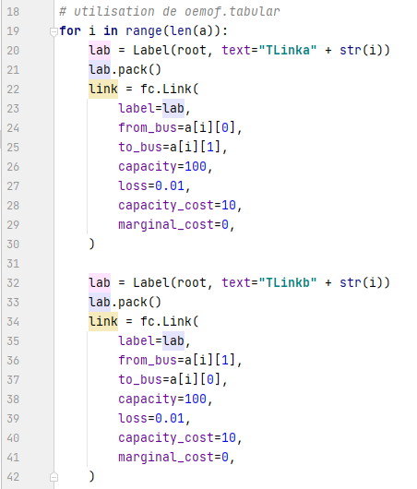
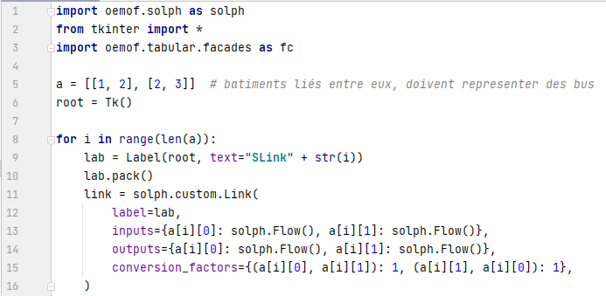
Application to the project

